Slide 2
Understanding Role-Based Access Control with ASP.NET Web APIs
Aditya Oberai

Slide 3

Hi, I am Aditya Oberai!
Developer Advocate @ Appwrite
Microsoft MVP
Connect with me:
Twitter: @adityaoberai1
LinkedIn: /in/adityaoberai1

Slide 4
Concepts We’ll Discuss
Role-Based Access Control (or RBAC)
JSON Web Tokens (or JWTs)
ASP.NET Web APIs

Slide 5
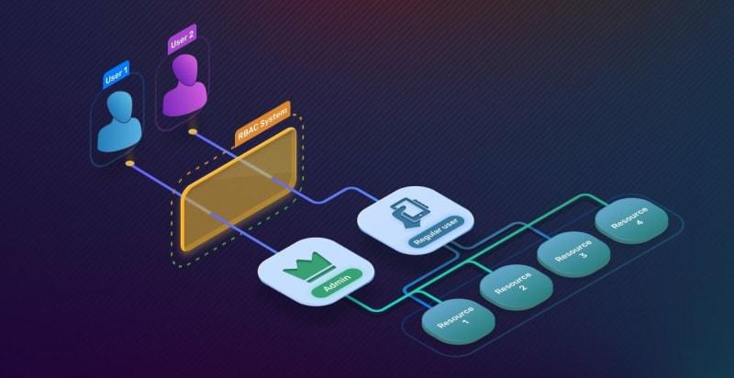
What is Role-Based Access Control?
Security model that restricts system access based on the roles assigned to users within an organization
Notes:
Provides a way to manage user permissions by associating users with specific roles and granting access to resources on their basis.
For e.g., in a WhatsApp group chat, you have a normal user and an admin. While the user can access necessary services such as sending and reading messages, admins get extra tooling like creating invite links or adding/removing users.

Slide 6
Pros of Role-Based Access Control
Principle of Least Privilege
Simplified Permissions Management
Consistency in Access Control
Easier Auditing
Increased Operational Efficiency
Easier to Implement Segregation of Duties
Improved Data Privacy and Security
Notes:
Principle of Least Privilege: RBAC enables organizations to enforce the principle of least privilege by giving users the minimal level of access – or permissions – needed to perform their jobs. This reduces the risk of accidental or deliberate misuse of permissions.
Simplified Permissions Management: Managing user permissions is easier because access is based on roles within the organization rather than on individual user attributes. Adding, removing, or altering roles adjusts permissions for all users associated with those roles, streamlining administration.
Consistency in Access Control: It standardizes access controls across the organization and enforces consistent implementation of security policies.
Easier Auditing: Having distinct roles makes it easier to audit user rights and ensure compliance with regulatory requirements. It also assists in identifying deviations from the norm, which could indicate a security issue.
Increased Operational Efficiency: Users receive a specific set of access rights when they assume a particular role, enabling them to perform their duties effectively without encountering access-related delays. When employees join, move within, or leave the organization, their user role and corresponding access rights can be quickly assigned or revoked, which improves operational efficiency.
Easier to Implement Segregation of Duties: RBAC facilitates the segregation of duties by clearly defining roles and ensuring that conflicting tasks are not assigned to the same role, which can prevent fraud and errors.
Improved Data Privacy and Security: By controlling who has access to sensitive data, organizations can better protect the privacy of personal and confidential information, which is increasingly important in the era of stringent data protection regulations.

Slide 7
Cons of Role-Based Access Control
Initial Setup Complexity
Role Explosion
Inflexibility in Dynamic Environments
Maintenance Overhead
Lack of Granularity
Dependency on Accurate Role Definitions
Notes:
Initial Setup Complexity: Defining roles can be a complex and time-consuming process, especially in large organizations with many users and varying levels of access requirements. It requires a thorough understanding of the business processes and careful planning.
Role Explosion: In large organizations or those with complex access needs, the number of roles can become unmanageable. Too many roles can make the system as difficult to manage as individual user permissions.
Inflexibility in Dynamic Environments: RBAC can be less flexible in environments where users’ tasks and access needs frequently change. It can be cumbersome to constantly create new roles or adjust existing ones to accommodate these changes.
Maintenance Overhead: Roles and permissions need to be regularly reviewed and updated to ensure they reflect current job requirements and security policies, which can be resource-intensive.
Lack of Granularity: Standard RBAC does not handle granular access control well, which can be necessary for certain applications or data access. This has led to the development of more granular systems such as Attribute-Based Access Control (ABAC).
Dependency on Accurate Role Definitions: The effectiveness of RBAC is highly dependent on the accuracy of the defined roles. If roles do not accurately reflect the organization’s operations, users will not have appropriate access.

Slide 8
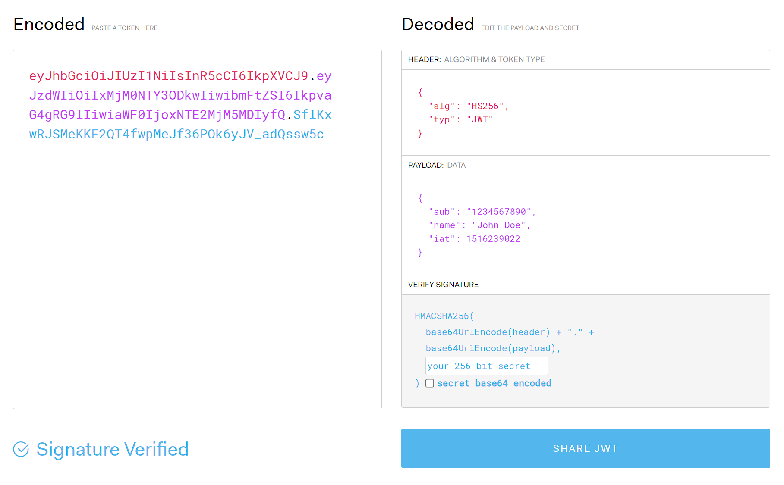
What are JSON Web Tokens?
Open standard that defines a compact and self-contained way for securely transmitting information between parties as a JSON object
Notes:
JSON Web Token is an open standard that defines a compact and self-contained way for securely transmitting information between parties as a JSON object.
This info is digitally signed so that it can be verified and trusted.
JWTs are stateless, meaning the server does not need to store token information. This makes JWTs scalable and suitable for client-server apps and distributed systems.

Slide 9
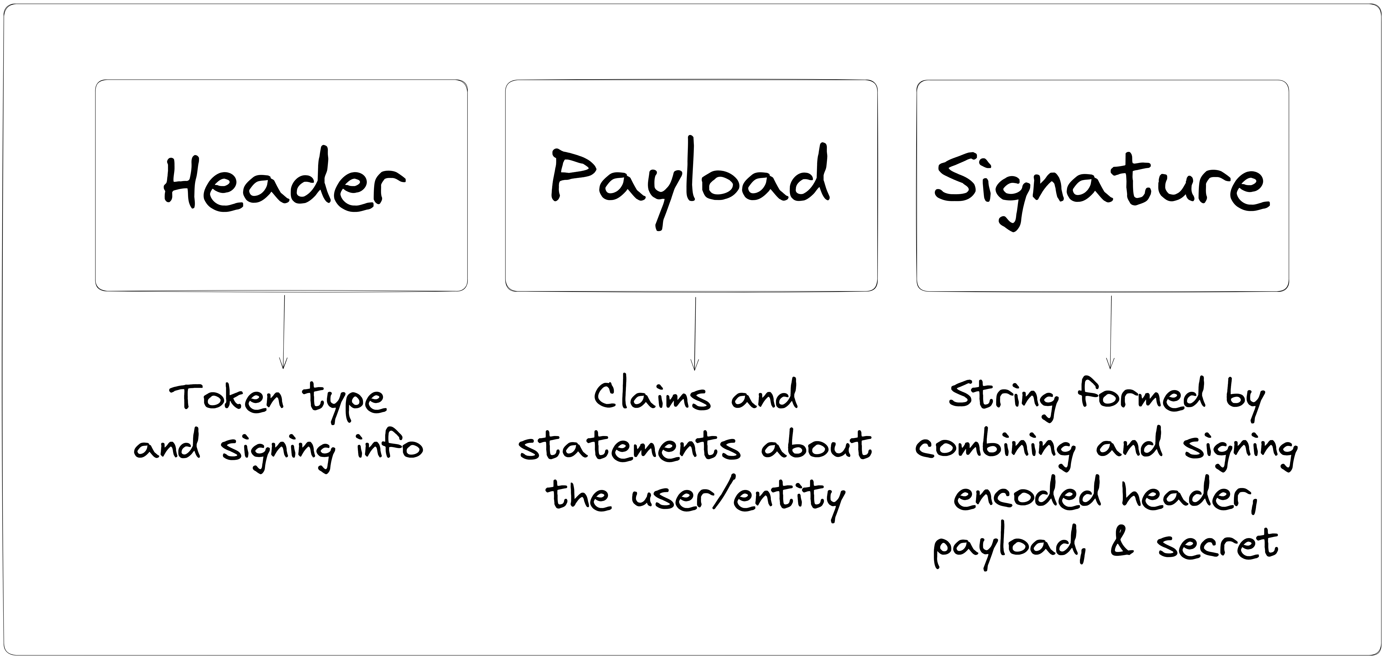
3 Parts of JSON Web Tokens
A JWT is made of 3 parts
Header
Payload
Signature
Notes:
Header: typically consists of two parts: the token type (which is JWT) and the signing algorithm used, such as HMAC, SHA256, or RSA. It is Base64Url encoded.
Payload: contains the claims or statements about the user or entity. Claims can include information like the user's ID, roles, permissions, expiration time, or any other relevant data. It is also Base64Url encoded.
Signature: created by taking the encoded header, the encoded payload, a secret key known only to the server, and applying the specified signing algorithm. The signature helps ensure the integrity of the token and prevents tampering.

Slide 10
How Servers Validate JWTs
The server decodes the JWT to extract the header and payload
The server verifies the signature by reapplying the signing algorithm to the header, payload, and secret key
The server checks the expiration time in the payload
The server may perform additional checks, such as verifying the token issuer, audience, etc.
Notes:
The server decodes the JWT to extract the header and payload
The server verifies the signature by reapplying the signing algorithm to the header, payload, and secret key. If the recalculated signature matches the signature in the JWT, it indicates that the token has not been tampered with.
The server checks the expiration time in the payload to ensure the token is not expired.
The server may perform additional checks depending on the app's requirements, such as verifying the token issuer, audience, or checking the token against a list of revoked tokens.

Slide 11
Implementing RBAC via JWTs in ASP.NET
Roles are set via claims
Claims are checked by the Authorization middleware
Applied by adding [Authorize(Roles = "<Role-To-Check>")] attribute to any action/controller
Can be achieved without using ASP.NET Core Identity

Slide 12
Demo

Slide 13

View The Project
Clone the GitHub repository:
github.com/adityaoberai/ RoleBasedAuthSample

Slide 14

Resources
Download .NET 8 aka.ms/get-dotnet-8
Get Visual Studio visualstudio.com

Slide 15
Any Questions?

Slide 16
Thank You!

Slide 17
Download .NET 8
https://aka.ms/get-dotnet-8

